Slide 1
Predictive Model for Flight Delays
An analysis using historical flight data
RANGANATH SHANKAR RAO
DATE - 1/8/2024

Slide 2
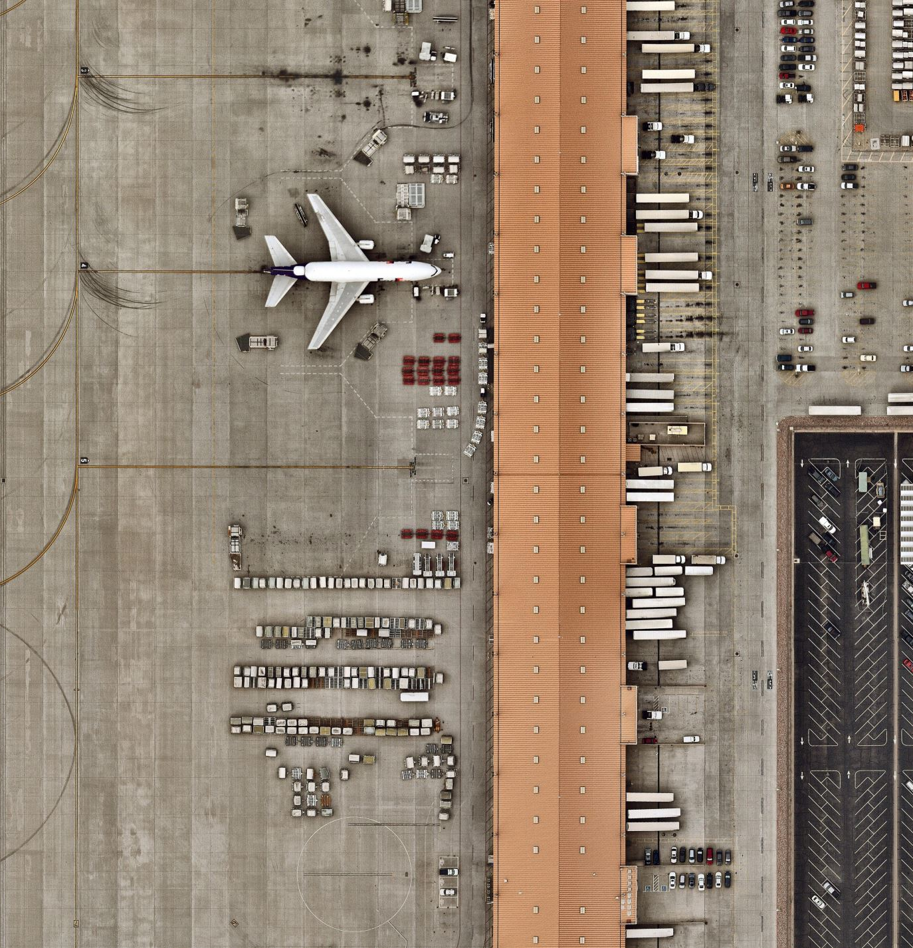
Introduction
Project Overview:
I was provided with two datasets – Flight_history.csv, which contains details on outbound flights from NYC airports from January to June 2013, and Flight_test.csv, consisting of randomly selected unique flights from the month of July.
My primary challenge is to predict which flights will arrive late using the ‘lateflight’ outcome variable. A late flight is defined as arriving after the scheduled arrival time.
The Flight_test.csv dataset provides minimal information, including variables such as uniqueid, year, month, day, scheduled departure and arrival times, carrier, flight number, tail number, origin, destination, and the dependent variable 'lateflight
Objective:
My goal is to construct additional meta-variables from the Flight_history.csv dataset, append them to Flight_test.csv, and build a predictive model to determine the likelihood of flight delays.

Slide 3
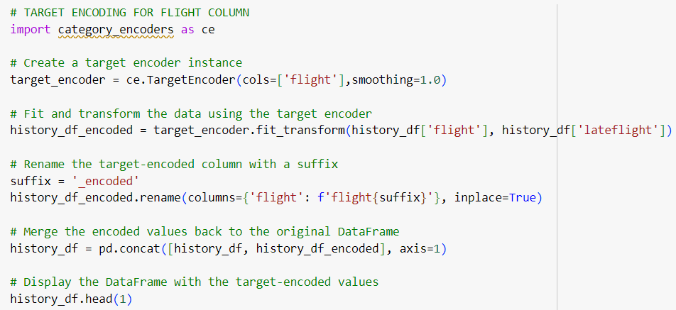
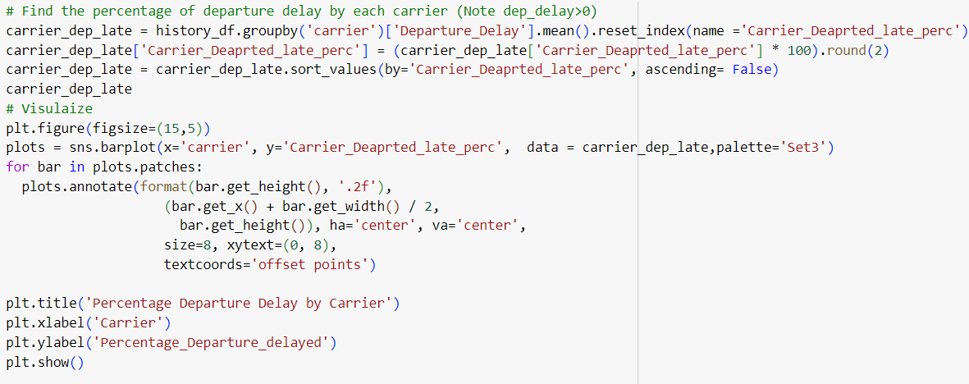
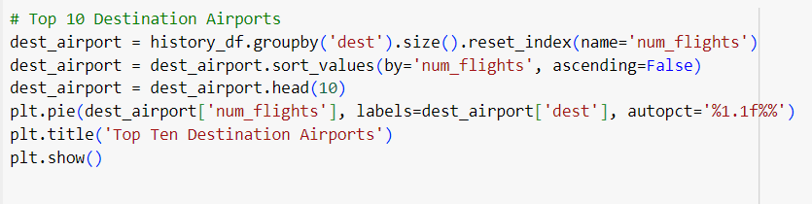
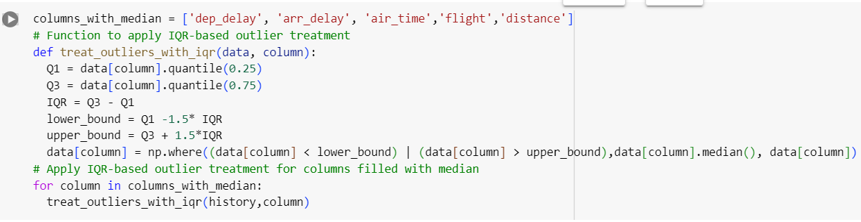
Agenda
Data Preprocessing
Exploratory Data Analysis

Slide 4
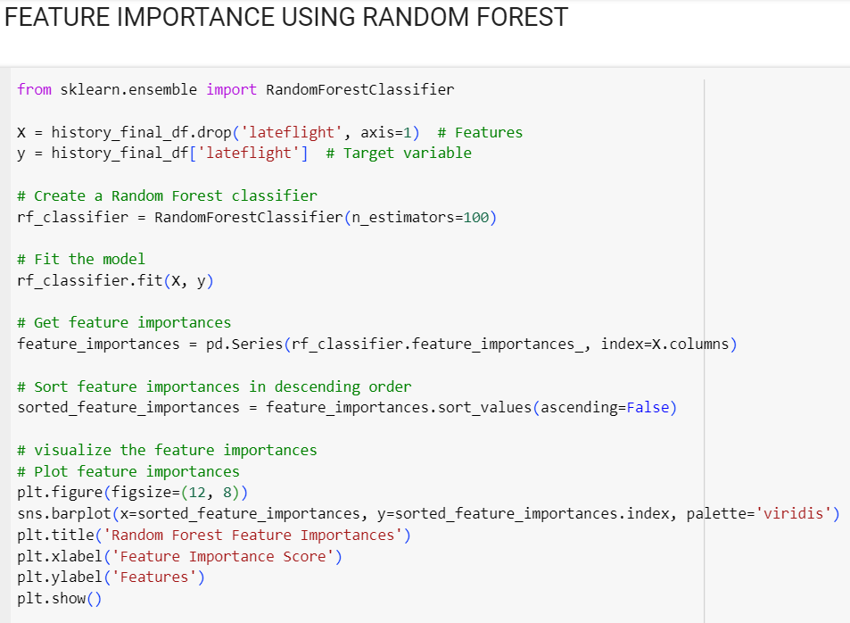
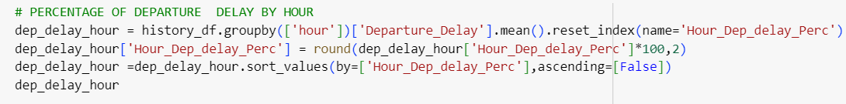
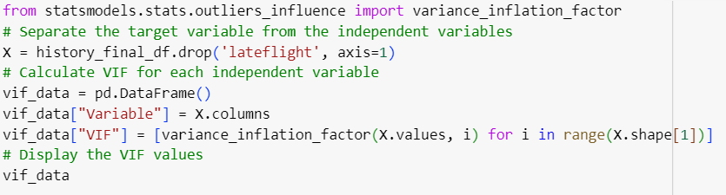
Agenda
Constructing Meta Variables
Feature Engineering

Slide 5
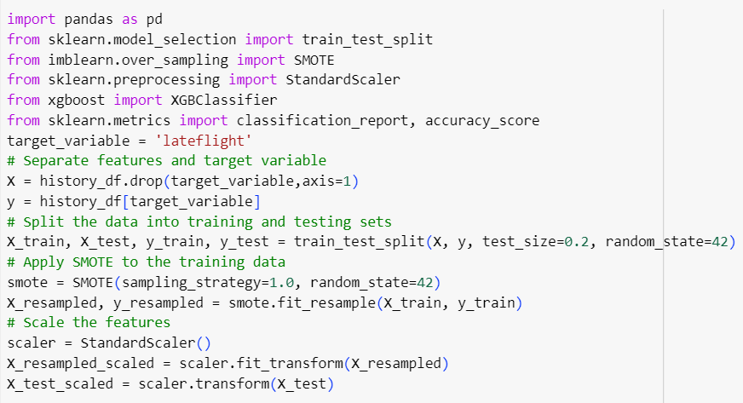
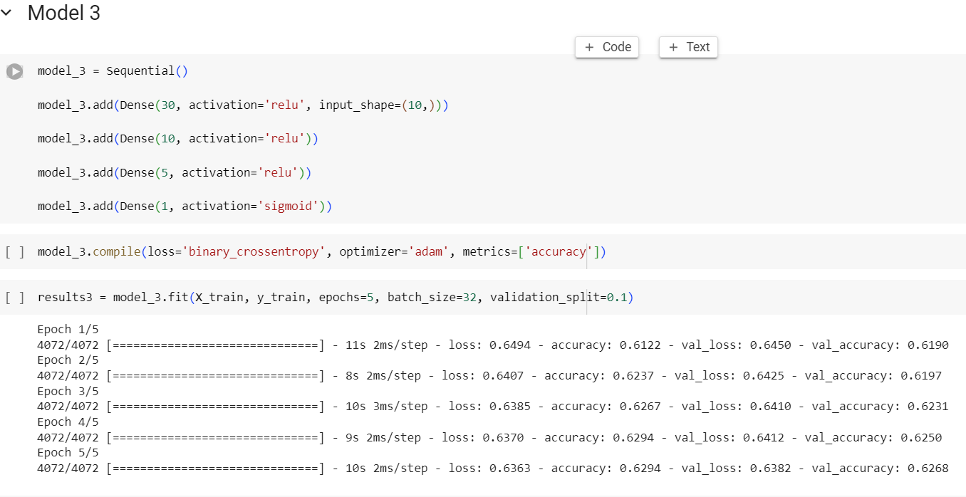
Agenda
Handling Imbalanced Data
Model Development and Testing:
Result Analysis

Slide 6
Data Preprocessing
Check for Duplicates
Handle missing values
Mean and Median Imputation
Value Imputation
Outlier Treatment
IQR Treatment
Z Score Treatment
Data Type conversions
Categorical Encoding
Dummy Encoding
Target Encoding
Data Scaling
Standard Scaler
Notes:
The no of missing values in dep_time is 4883 and % of missing values is 2.94 %
The no of missing values in dep_delay is 4883 and % of missing values is 2.94 %
The no of missing values in arr_time is 5101 and % of missing values is 3.07 %
The no of missing values in arr_delay is 5480 and % of missing values is 3.3 %
The no of missing values in air_time is 5480 and % of missing values is 3.3 %
The no of missing values in tailnum is 1521 and % of missing values is 0.92 %
1. The dep_time field is normally distributed with very little outliers. Hence we can use the mean to fill the missing values
2. The dep_delay field has large number of positive outliers and the histogram indicates it is positively skewed. Hence we can use the median to fill the missing values
3. The arr_time filed is normally distributed with no outliers. We can use mean to fill the missing values
4. The arr_delay field has a lot of positive outliers and is positively skewed. Hence we can use median to fill the missing values.
5. The Air Time field contains outliers and it is also positively skewed. Hence we can use the median to fill the outliers.
After IQR
Number of outliers in 'dep_delay' column: 19889
Number of outliers in 'arr_delay' column: 9490
Number of outliers in 'air_time' column: 15285
Number of outliers in 'flight' column: 0
Number of outliers in 'distance' column: 0
AFTER ZSCORE – 0
Categorical Encoding
The number of unique features in carrier are 16
The number of unique features in flight are 2986
The number of unique features in tailnum are 3818
The number of unique features in origin are 3
The number of unique features in dest are 100
Scaling.

Slide 7
Exploratory Data Analysis
Carrier Analysis
Origin Airport Analysis
Destination Airports Analysis
Seasonality Analysis

Slide 8
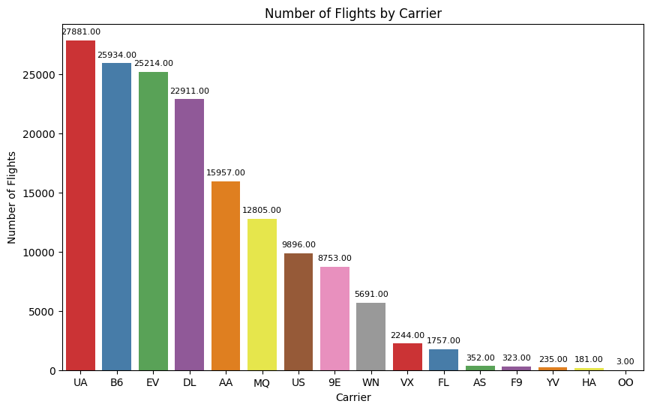
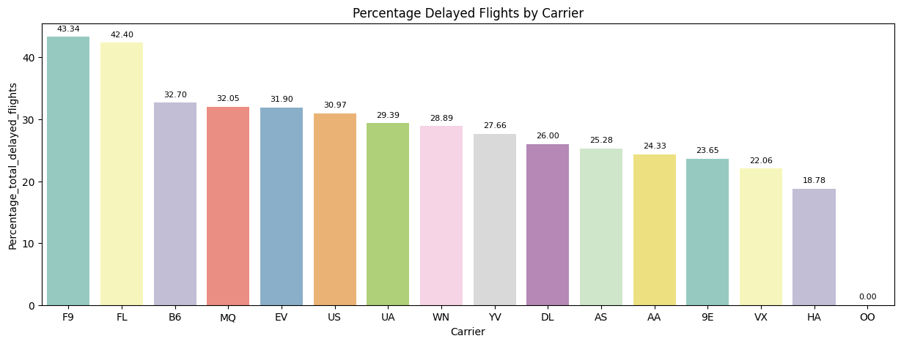
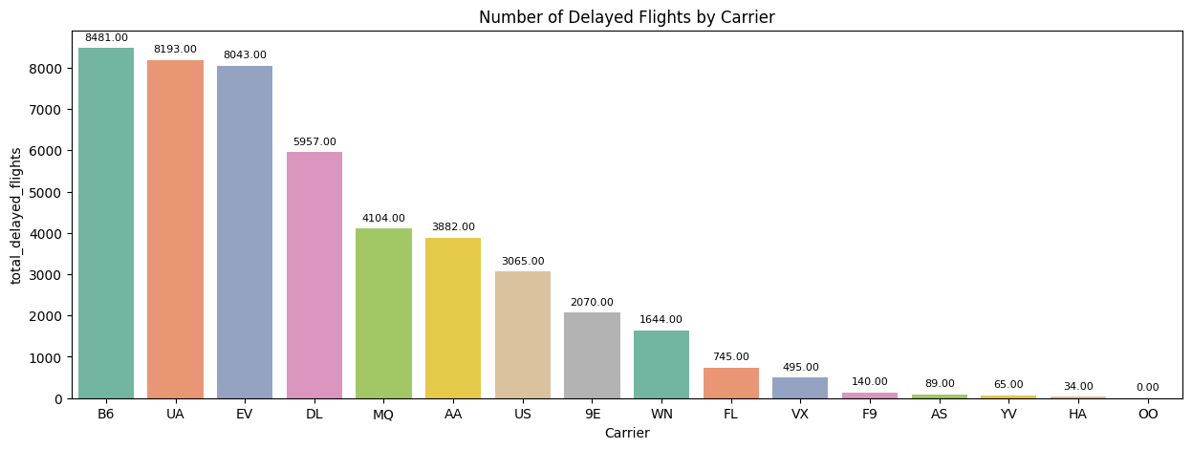
Carrier EDA Analysis:
Highest Percentage of Delayed Flights: F9
Lowest Percentage of Delayed Flights: OO
Highest Total Number of Flights: UA
Lowest Total Number of Flights: OO
Highest Total Number of flights Delayed:B6
Lowest Total Number of flights Delayed: OO

Slide 9
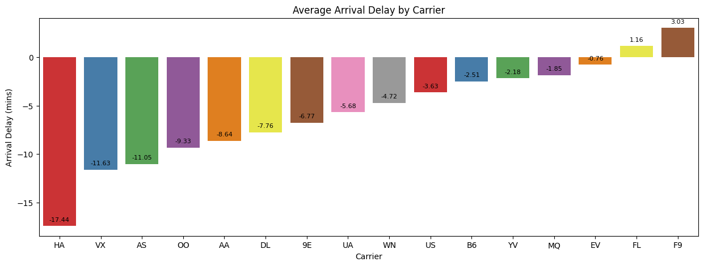
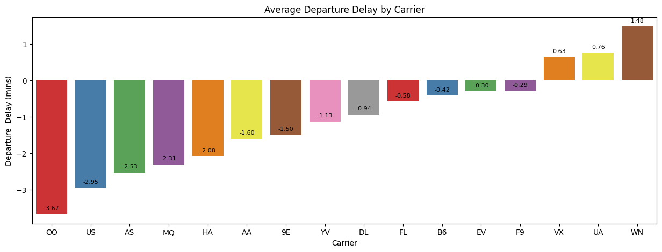
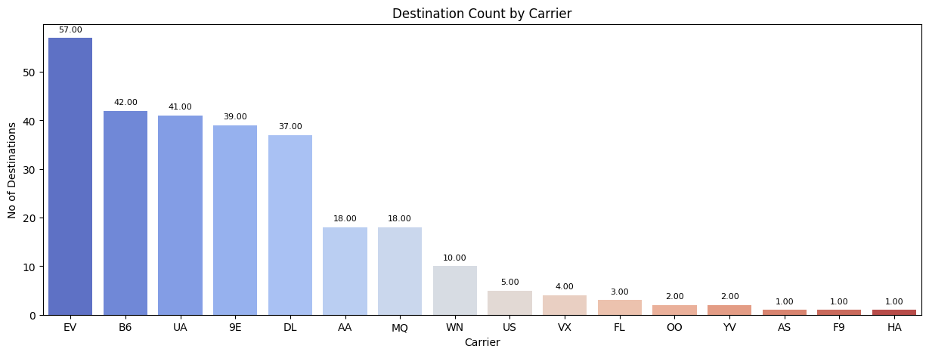
Carrier EDA Analysis:
Highest Average Arrival Delay: F9
Lowest Average Arrival Delay : HA
Highest Average Departure Delay: WN
Lowest Average Departure Delay : OO
Highest Destination Count: EV
Lowest Destination Count: HA

Slide 10
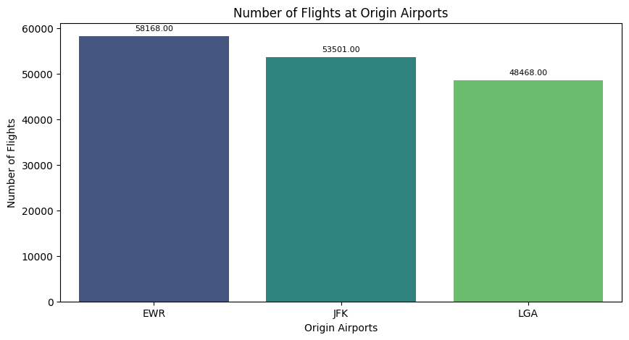
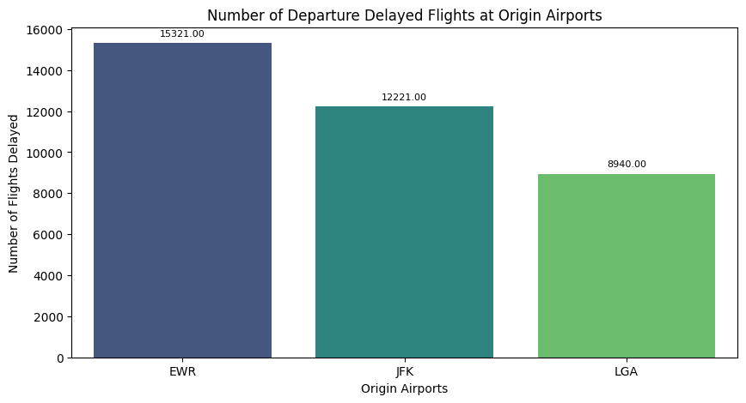
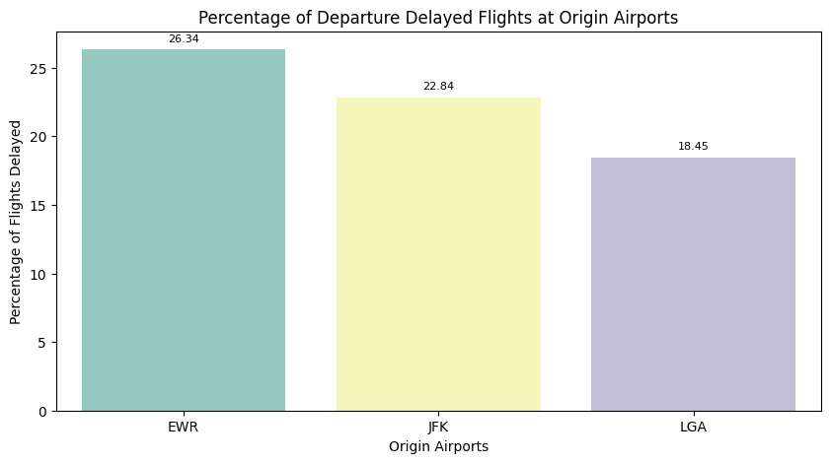
Origin Airport EDA Analysis:
Highest No of Flights : EWR
Lowest No of Flights : LGA
Highest No of Departure Delay : EWR
Lowest No of Departure Delay : LGA
Highest Percentage Departure Delay : EWR
Lowest Percentage Departure Delay : LGA

Slide 11
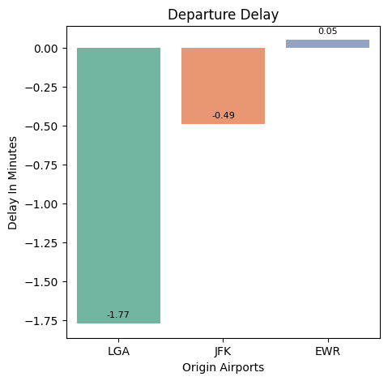
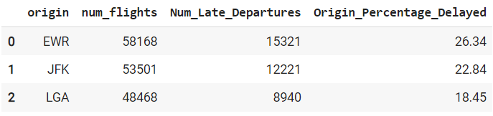
Origin Airport EDA Analysis:
Highest Average Departure Delay : EWR
Lowest Average Departure Delay : LGA
Best Performing Origin Airport: LGA
Least Performing Origin Airport: EWR

Slide 12
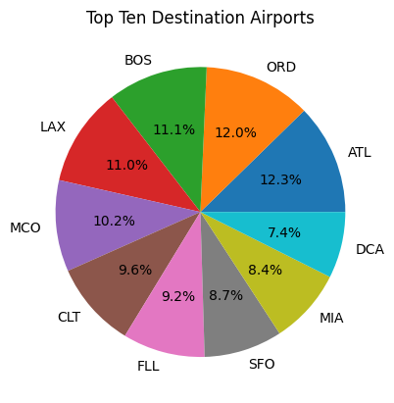
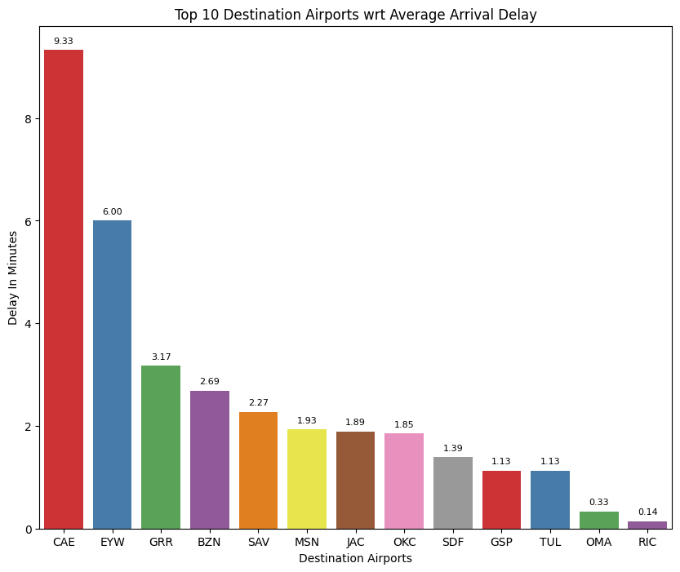
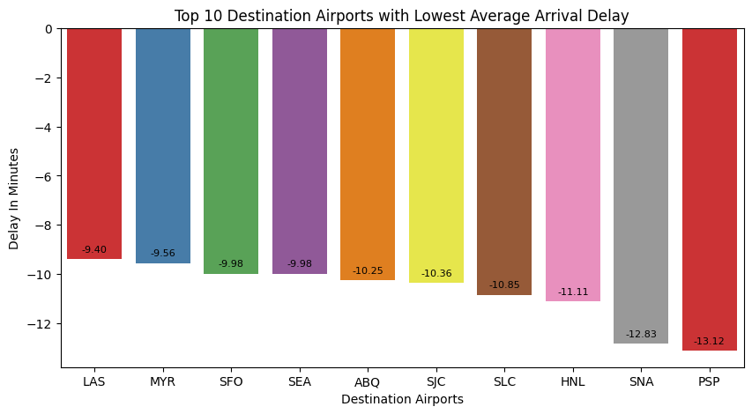
Destination Airport EDA Analysis:
There are 100 Destination Airports
Top 5 Destinations : ATL,ORD,BOS,LAX,MCO
Highest Average Arrival Delay: CAE
Lowest Average Arrival Delay: PSP

Slide 13
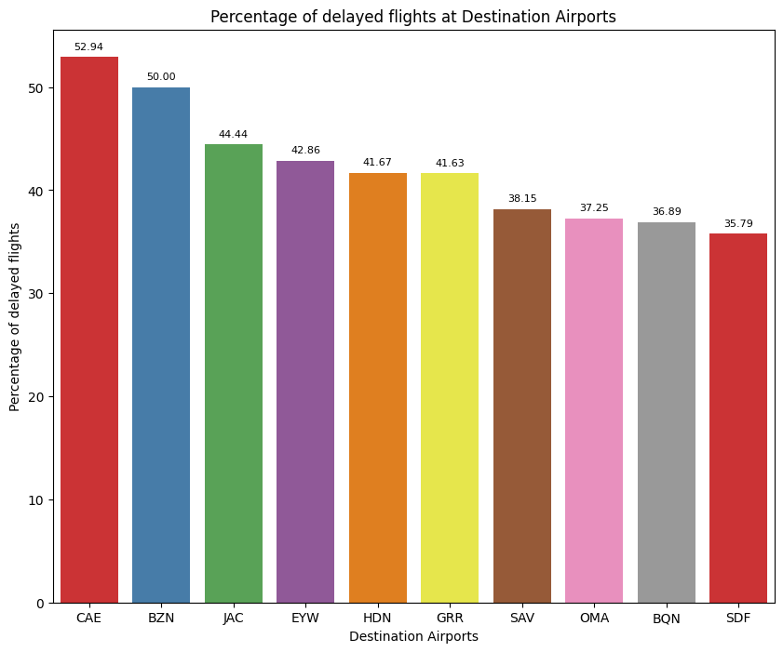
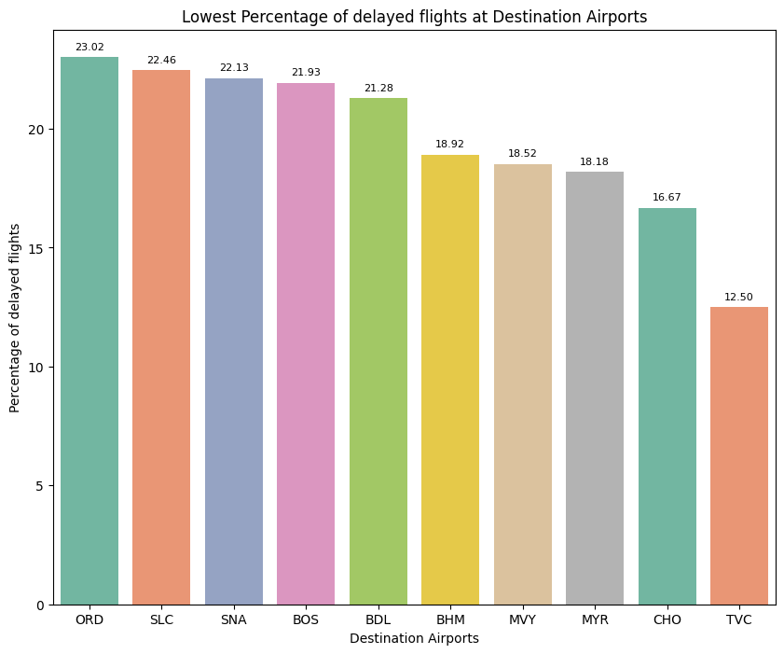
Destination Airport EDA Analysis:
Highest Percentage of Delayed Flight: CAE
Lowest Percentage of Delayed Flight: TVC
Overall, we can say that Destination Airport CAE with Highest Average Arrival Delay and Highest percentage of delayed flights as poor performing airport

Slide 14
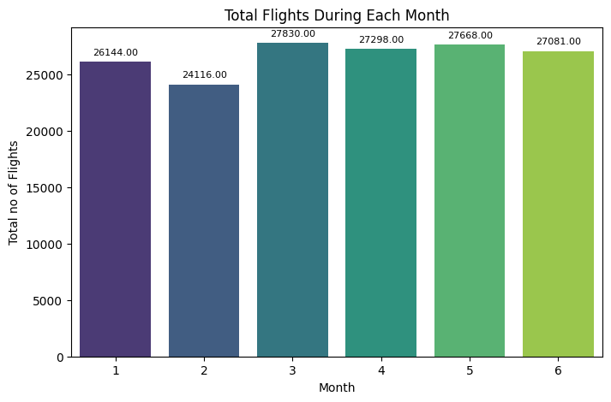
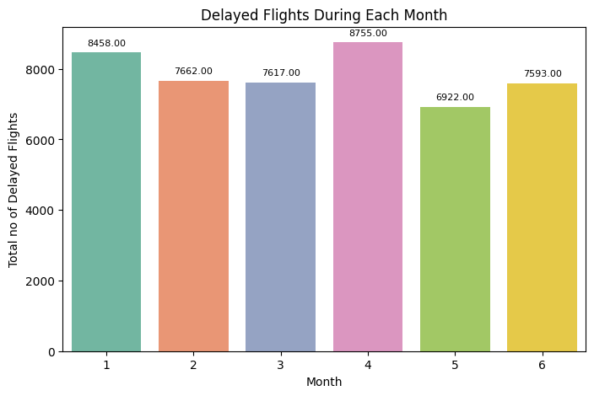
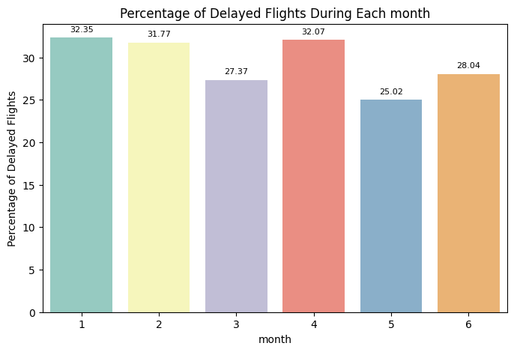
Seasonality EDA Analysis:
Highest No of Flights : March
Lowest No of Flights : February
Highest No of Delayed Flights : April
Lowest No of Delayed Flights : May
Highest Percentage Delayed Flights : January
Lowest Percentage Delayed Flights : May
Overall Performance in the Month of May is good as it has second highest no of flights and lowest percentage of flights delayed.

Slide 15
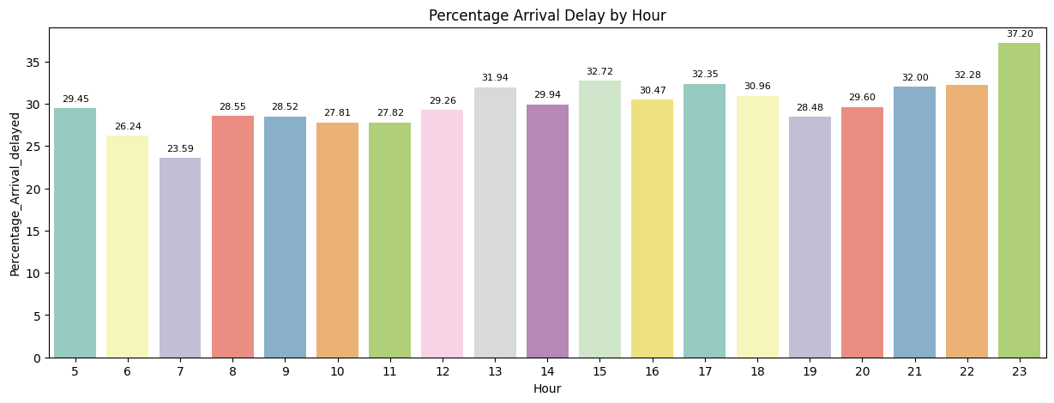
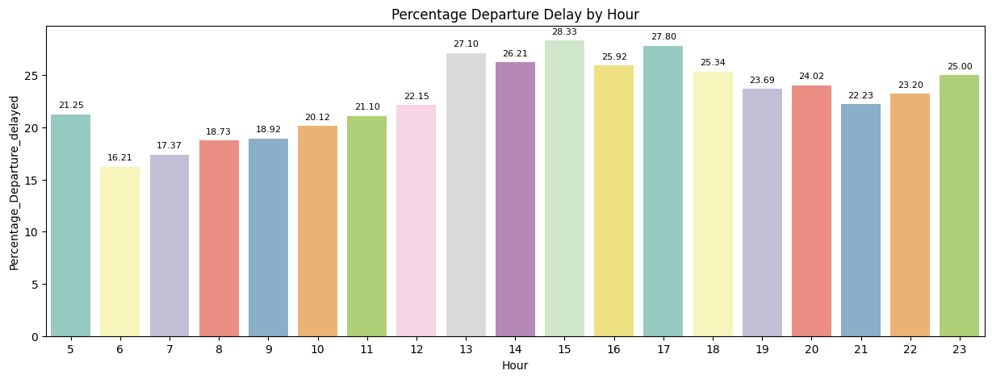
Peak Hours for Arrival Delays:
The highest percentage of arrival delays is observed at 23:00 (11:00 PM) with 37.20%.
Other peak hours for arrival delays include 15:00 (3:00 PM) and 17:00 (5:00 PM) with percentages above 32%.
Peak Hours for Departure Delays:
The highest percentage of departure delays is observed at 15:00 (3:00 PM) with 28.33%.
Other peak hours for departure delays include 17:00 (5:00 PM), 22:00 (10:00 PM), and 21:00 (9:00 PM) with percentages above 27%.
Lowest Delays:
The lowest percentage of arrival and departure delays is observed during early morning hours, specifically at 7:00 (7:00 AM) and 6:00 (6:00 AM).
This suggests that flights during these hours tend to have lower delays.

Slide 16
Constructing Meta Variables
Carrier-related features:
Carrier_Arrival_Delayed_Percentage: This captures the general tendency of a specific carrier to experience arrival delays, providing valuable context for individual flights.
Carrier_Deaprted_late_perc: Similar to above, this indicates the carrier's propensity for departure delays, which can lead to cascading downstream delays.
Carr_Dest_Arrival_delay: Captures the carrier's historical delay patterns for specific arrival destinations, revealing potential route-specific challenges.
Carr_Day_Arrival_delay: This considers the carrier's delay tendencies on specific days of the week, accounting for potential schedule or operational limitations.
Origin and Destination-related features:
Origin_Percentage_Delayed: Identifies airports with higher historical rates of departure delays, allowing for early risk assessment for flights originating from those locations.
Dest_Arrival_delay_Percent: Similar to above, this highlights destinations with frequent arrival delays, providing context for potentially challenging landing conditions or airspace congestion.

Slide 17
Constructing Meta Variables
Time-related features:
Hour_Arr_delay_Perc: Captures the hourly pattern of arrival delays, revealing periods with higher probability of disruptions.
Hour_Dep_delay_Perc: Similar to above, this identifies peak hours for departure delays, allowing for preventive measures or contingency planning.
Tailnumber-related features:
tail_delay_percent: Focuses on specific aircraft and their historical delay patterns, which could be due to maintenance issues or technical specifications.
tail_arr_delay: Similar to above, this highlights individual aircraft with a higher tendency for arrival delays, potentially indicating maintenance needs or operational factors.
Overall, I have chosen features covering various aspects that could influence flight delays, ranging from carrier performance and route specific challenges to time-based patterns and individual aircraft characteristics. I believe this approach will improve model’s ability to capture complex relationships and predict delays more accurately.

Slide 18
Feature Engineering
Correlation Analysis
Variance Inflation Factor – To check Multicollinearity
Recursive Feature elimination - To select optimal features for model training
Feature Importance using Random Forest
Fisher’s score
I have performed feature engineering on both Imbalanced and balanced data.

Slide 19
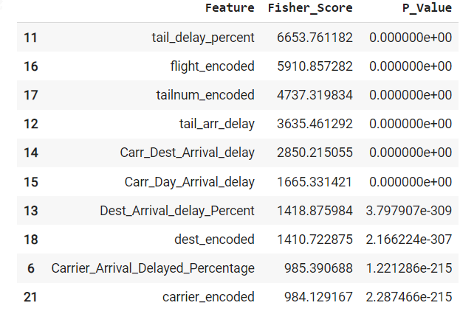
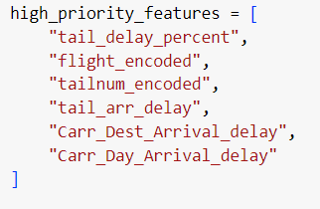
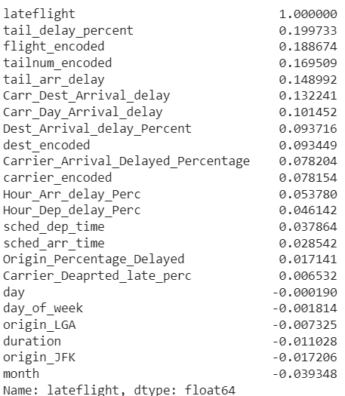
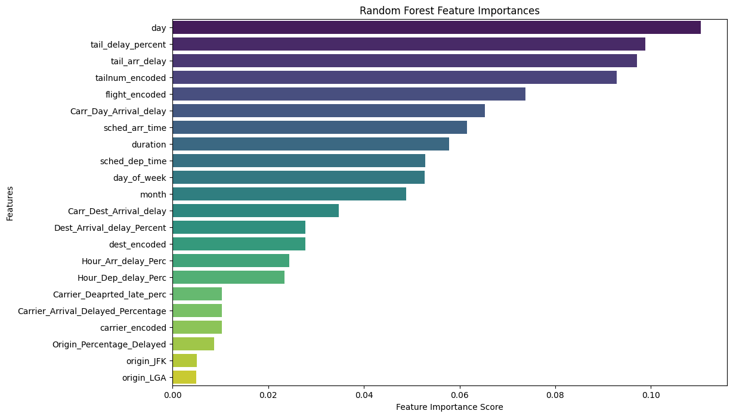
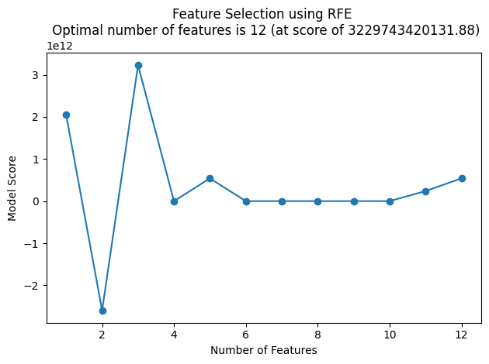
Feature Engineering –Imbalanced Data
Correlation Values

Slide 20
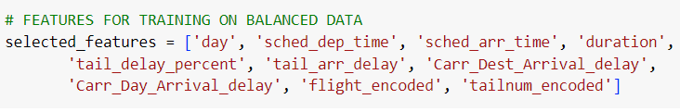
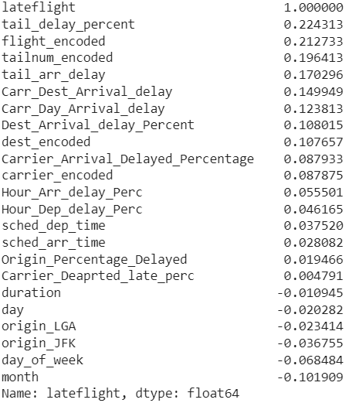
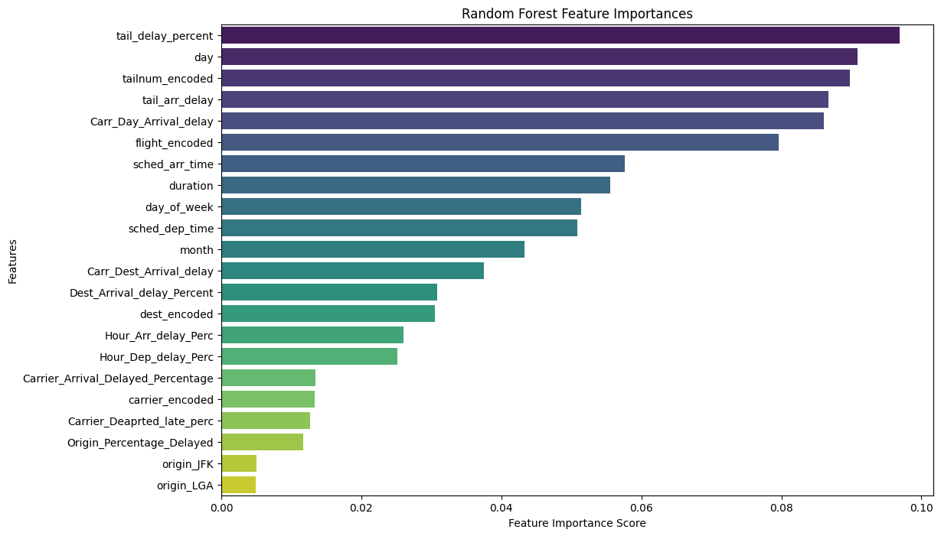
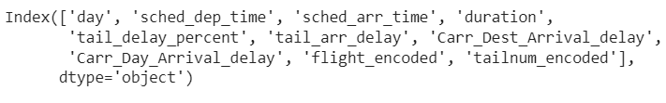
Feature Engineering –Balanced Data
Correlation Values
RFE – Top 10 Features

Slide 21
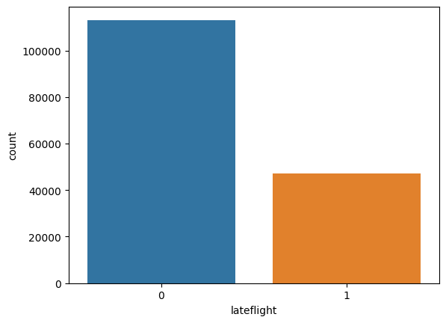
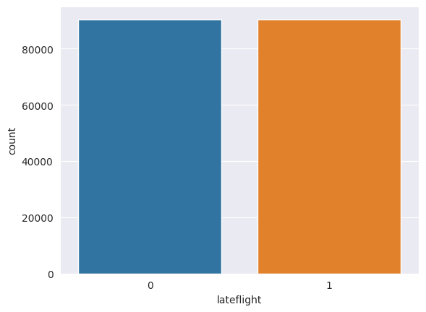


Handle Imbalance data
Utilized SMOTE(Synthetic Minority Oversampling Technique) to balance the data
IMBALANCED DATA
BALANCED DATA – USING SMOTE

Slide 22
Model Training on Balanced and Imbalanced Data
 |  | IMBALANCED DATA |  |  |  | BALANCED DATA
SL NO | ALGORITHM | ACCURACY | F1 SCORE | PRECISION | RECALL | ACCURACY | F1 SCORE | PRECISION | RECALL
1 | LOGISTIC REGRESSION | 71.00 | 16.00 | 56.00 | 10.00 | 61.00 | 61.00 | 61.00 | 61.00
2 | DECISION TREE CLASSIFIER | 61.00 | 33.00 | 33.00 | 33.00 | 66.00 | 67.00 | 66.00 | 67.00
3 | KNN CLASSIFIER | 66.00 | 30.00 | 38.00 | 24.00 | 66.00 | 68.00 | 64.00 | 73.00
4 | GAUSSIAN NB CLASSIFIER | 66.00 | 41.00 | 41.00 | 41.00 | 61.00 | 63.00 | 59.00 | 68.00
5 | RANDOM FOREST CLASSIFIER | 66.00 | 28.00 | 38.00 | 22.00 | 75.00 | 75.00 | 74.00 | 75.00
6 | RANDOM FOREST- HYPER PARA TUNING |  |  |  |  | 75.00 | 75.00 | 75.00 | 75.00
7 | VOTING CLASSIFIER | 70.20 | 20.00 | 48.00 | 13.00 | 65.00 | 63.00 | 67.00 | 60.00
8 | GRADIENT BOOSTING | 71.07 | 18.00 | 52.00 | 11.00 | 68.00 | 68.00 | 68.00 | 69.00
9 | ADA BOOST CLASSIFIER | 71.02 | 18.00 | 52.00 | 11.00 | 68.00 | 68.00 | 68.00 | 69.00
10 | XGBOOST CLASSIFIER | 70.73 | 18.00 | 52.00 | 11.00 | 73.00 | 71.00 | 76.00 | 66.00

Slide 23
Model Training on Balanced and Imbalanced Data –MLP Neural Network
 |  | IMBALANCED DATA |  |  |  | BALANCED DATA
SL NO | ALGORITHM - MLP NEURAL NETWORK | ACCURACY | F1 SCORE | PRECISION | RECALL | ACCURACY | F1 SCORE | PRECISION | RECALL
1 | MODEL 1 | 70.73 | 29.13 | 50.01 | 20.55 | 62.82 | 64.51 | 62.02 | 67.22
2 | MODEL 2 | 70.73 | 29.13 | 50.01 | 20.55 | 62.82 | 64.51 | 62.02 | 67.22
3 | MODEL3 | 71.33 | 12.65 | 58.33 | 7.09 | 63.11 | 65.04 | 62.11 | 68.25
4 | MODEL4 | 71.36 | 15.54 | 56.72 | 9.00 | 63.14 | 64.15 | 62.77 | 65.60
5 | MODEL 5 | 70.73 | 29.13 | 50.01 | 20.55 | 62.82 | 64.51 | 62.02 | 67.22
6 | MODEL 6 | 71.35 | 13.38 | 58.11 | 7.56 | 62.74 | 65.79 | 61.11 | 71.26
7 | MODEL 7 | 71.32 | 19.07 | 54.76 | 11.54 | 63.60 | 63.81 | 63.78 | 63.84

Slide 24
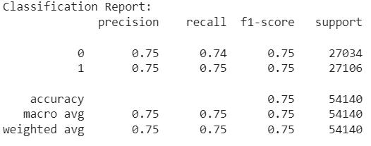
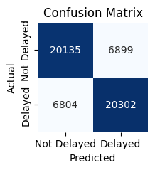
Best Performing Model
Out of the total 33 Models trained on Balanced and Imbalanced Data the best Model is Random Forest Classifier. The results are below:

Slide 25
Testing on Test Data Set
I carried out the same data preprocessing steps applied on Training data on the Test data as well.
Merged all the required optimal features to the test data generated from the train data.
The Random Forest model was used to predict on the processed Test Data
The results are continued in the next slide..

Slide 26
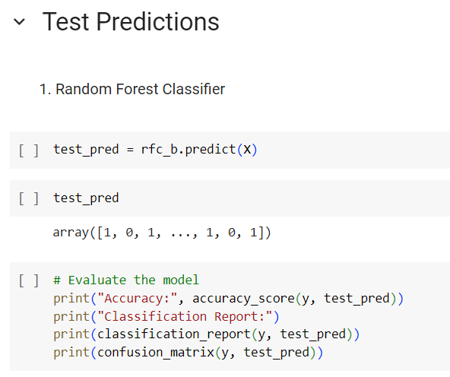
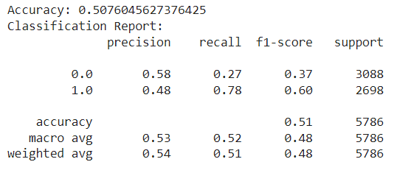
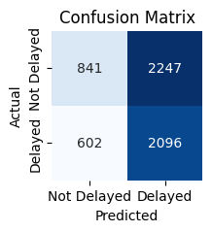
Test Data Results

Slide 27
Test Result Analysis
Overall Performance:
Accuracy: 50.76%, indicating the model correctly predicts flight delays about half the time. This relatively low accuracy suggests room for improvement.
Class-Specific Performance:
Precision for class 0 (non-delayed flights): 58%, meaning when the model predicts a flight as on-time, it's correct 58% of the time.
Recall for class 0: 27%, indicating the model correctly identifies only 27% of actual non-delayed flights.
Precision for class 1 (delayed flights): 48%, meaning when the model predicts a delay, it's correct 48% of the time.
Recall for class 1: 78%, indicating the model correctly identifies 78% of actual delayed flights.
Pros and Cons:
High recall for delayed flights (78%): This shows the model excels at identifying flights that actually arrive late, which is directly aligned with the given goal. This is a positive aspect of the model's performance.
Low recall for on-time flights (27%): However, the model struggles to correctly identify flights that arrive on time. This is a significant drawback, as it misses a large portion of the target class (potentially on-time flights that could benefit from proactive interventions).

Slide 28

Thank You

